Slide 1

Project 6:
Health Insurance Objectives
Health insurance is an essential component of healthcare access, providing financial protection against the high costs of medical care. However, navigating the complexities of health insurance can be challenging for individuals and families, especially as premiums, deductibles, and out-of-pocket expenses continue to rise.
Objective
Identify the attributes that contribute to the increase in health insurance costs.
Methods
Python
Tableau
Exploratory data analysis
Data cleaning
Consistency checks
Data modeling

Slide 2
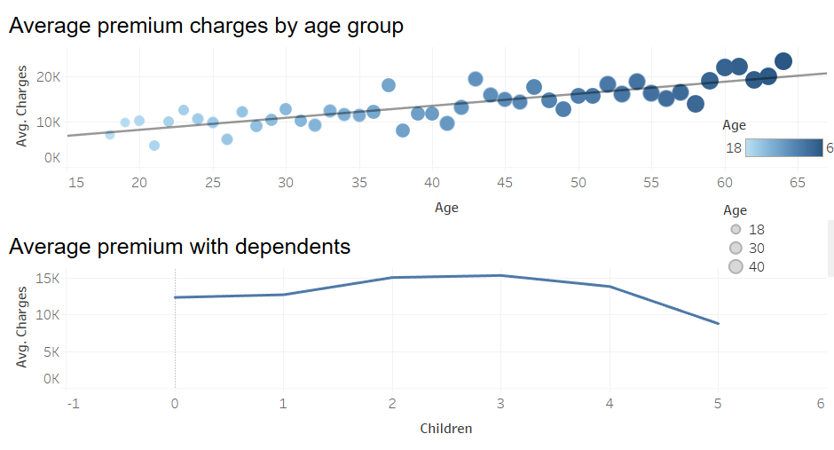
Health Insurance Analysis
The trend line depicting average insurance charges for individuals aged 18-64 years shows a positive correlation between age and insurance costs.
As individuals age, their likelihood of requiring more frequent or intensive healthcare increases, which results in higher insurance premiums.
Insurance tends to increase with more than one kid but does show a decline when an individual has more than 3 kids.

Slide 3
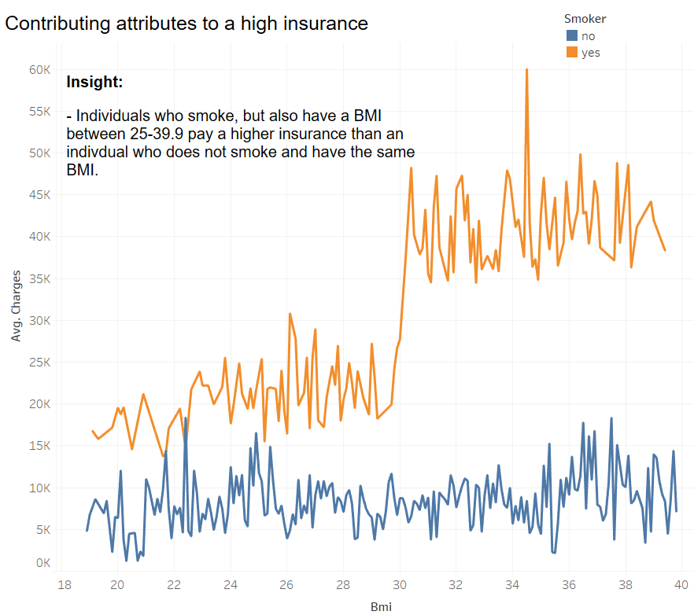
Health Insurance Analysis

Slide 4
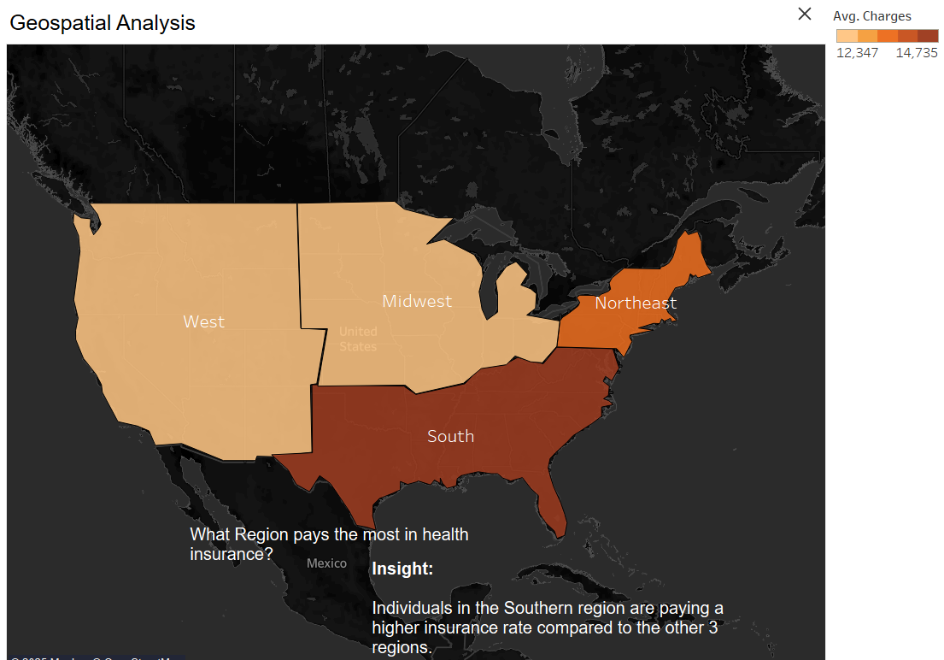
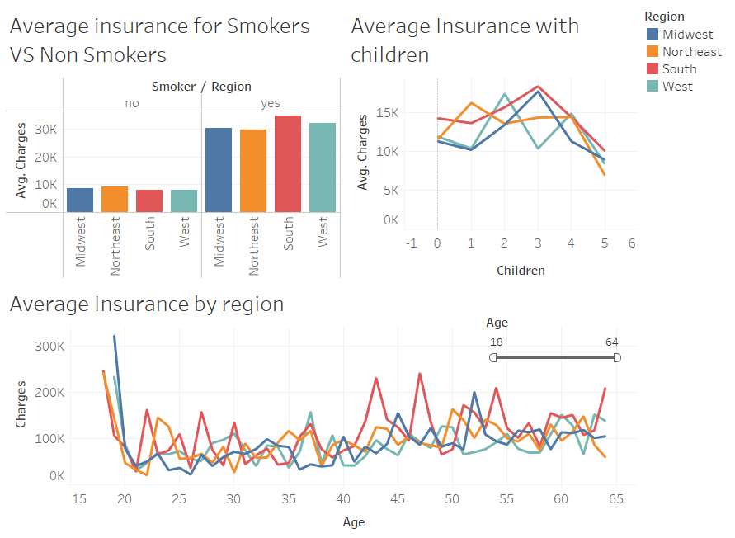
Health Insurance Analysis
The Southern region has the most smokers, the most individuals with more than 2 dependents and the most individuals by age group on average paying a higher insurance.

Slide 5
Health Insurance Recommendations
Next steps:
Age-Based Premium Structuring:
- Refine pricing models by introducing more age-segmented policies. For example, providing coverage packages that cater specifically to seniors, could improve customer satisfaction.
Adjustments based of number of dependents
- Medicaid or CHIP may offer low-cost or free health insurance for your children. Eligibility depends on income and family size.
Targeted Premium Adjustments for Smokers:
- Insurers could consider offering smoking cessation programs as incentives for policyholders.
BMI-Related Premium Adjustments:
- Introducing programs to encourage healthy living, such as weight-loss challenges or wellness programs. Offer reduced premiums for individuals who participate.

